Slide 1
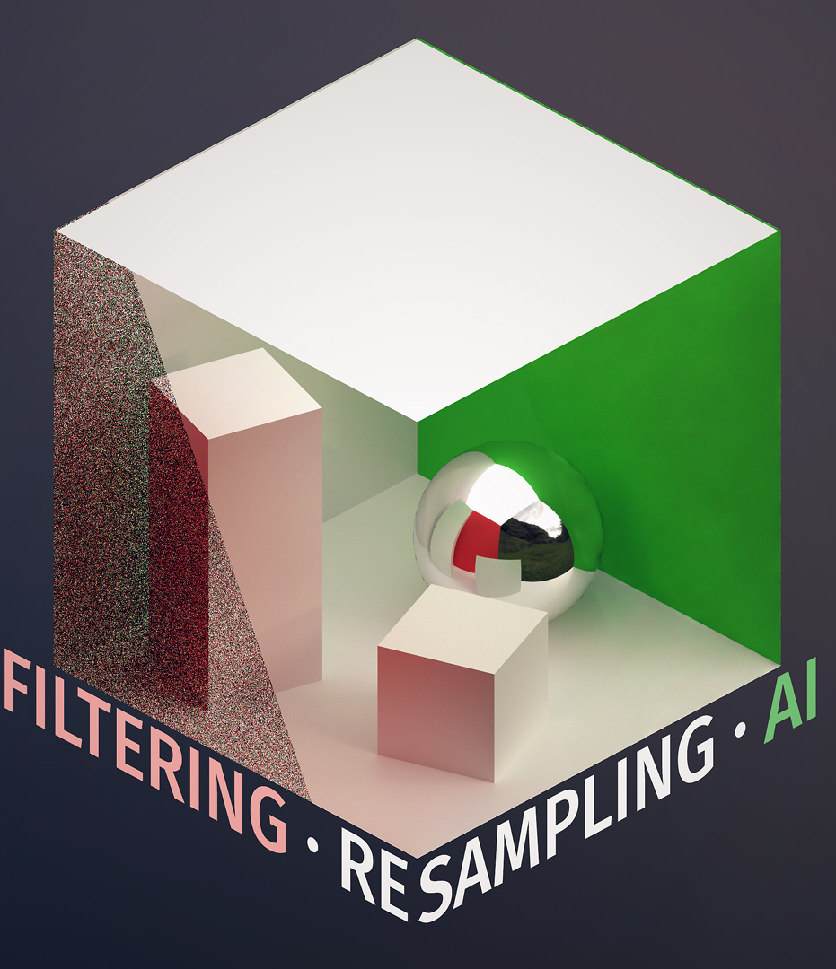
REAL TIME DENOISING WITH DL: Milestone 3
Ryan Tong, Tom Donnelly, Shixuan Fang
Advised by Liam Dugan

Slide 2
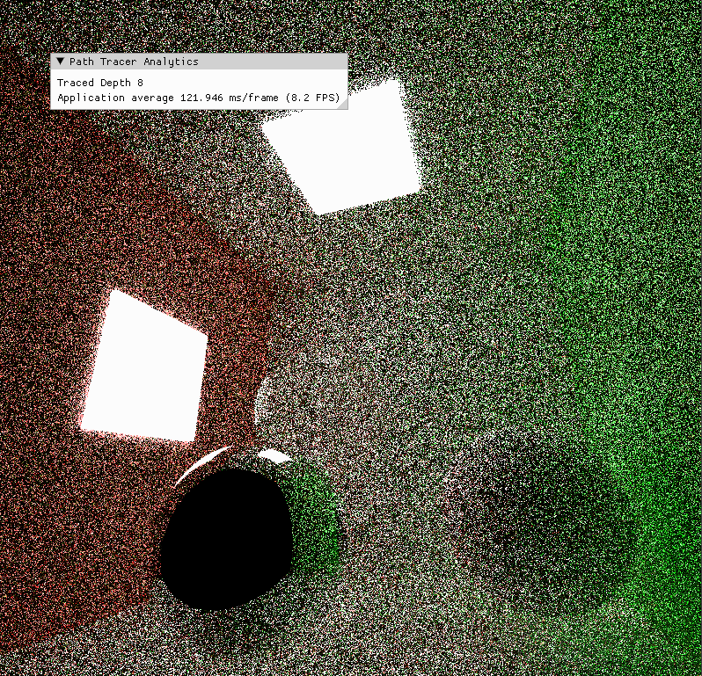
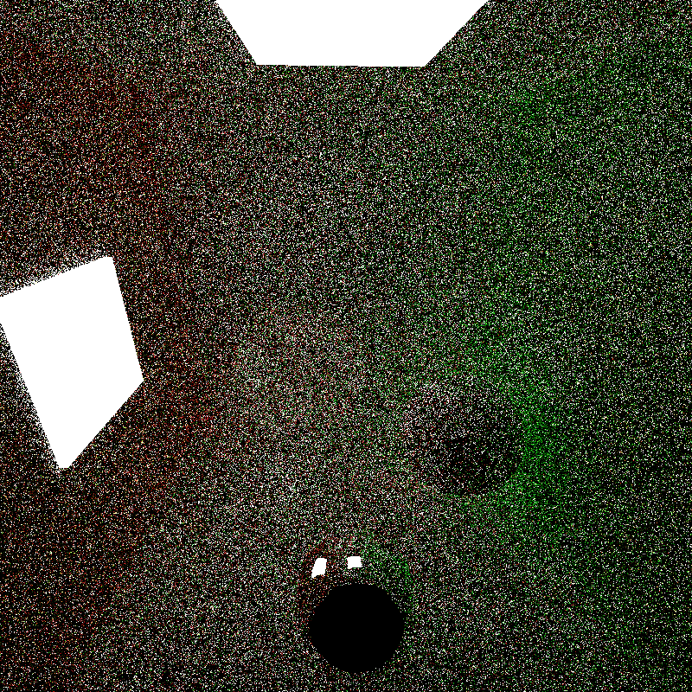
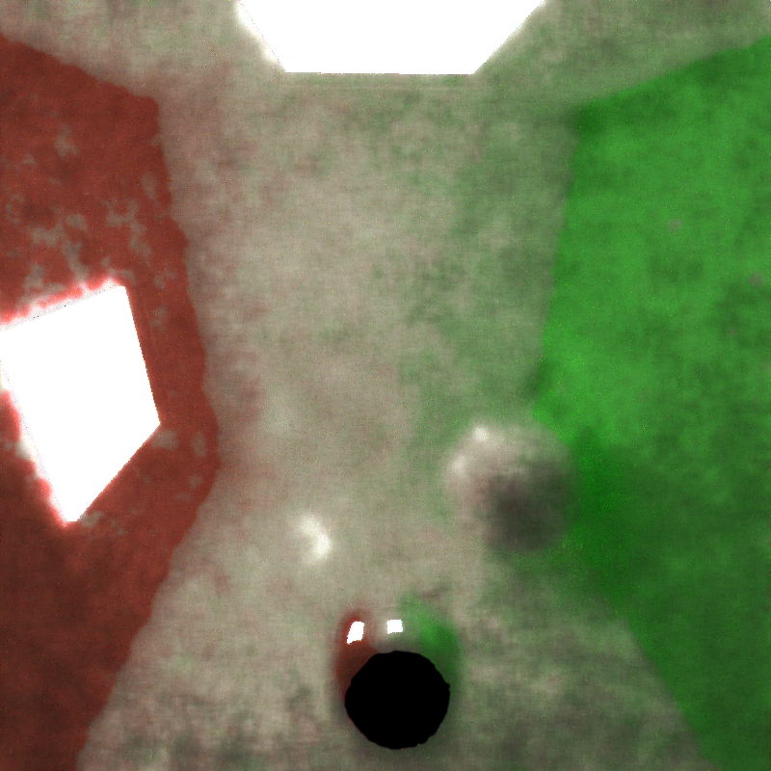
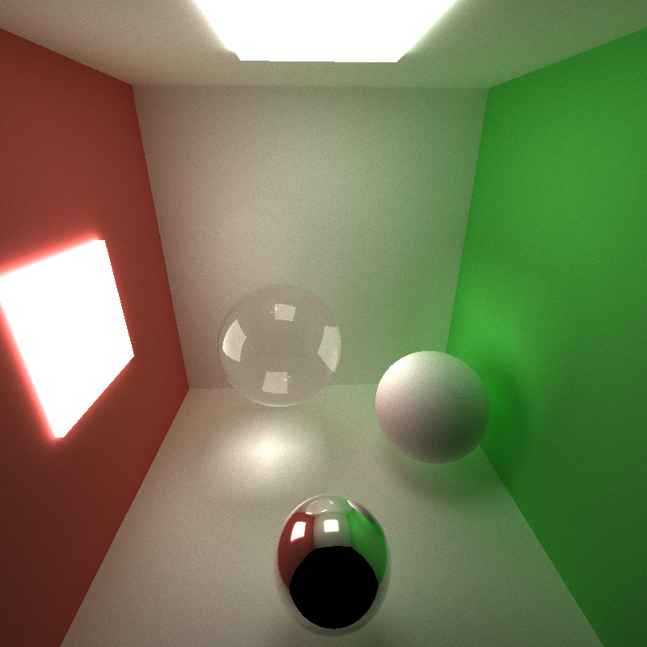
Previous Milestone
Data collection pipeline
cuDNN code to run an example image through model
Scene generator
Model training pipeline

Slide 3
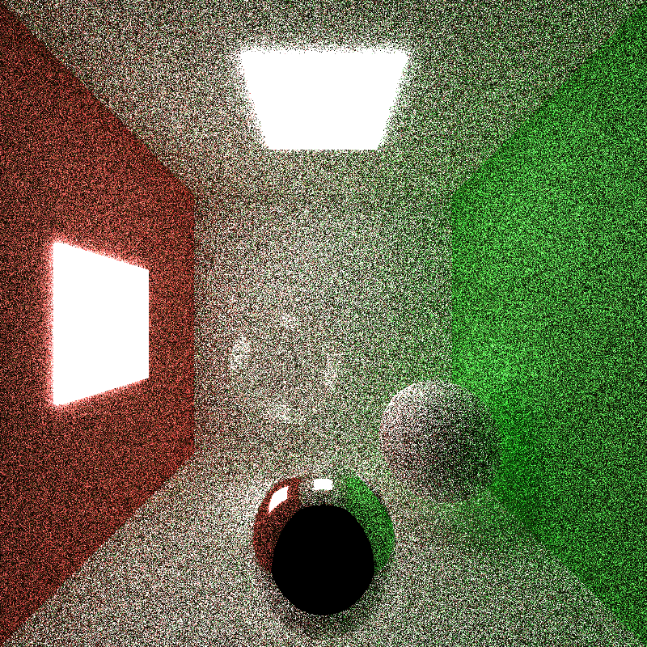
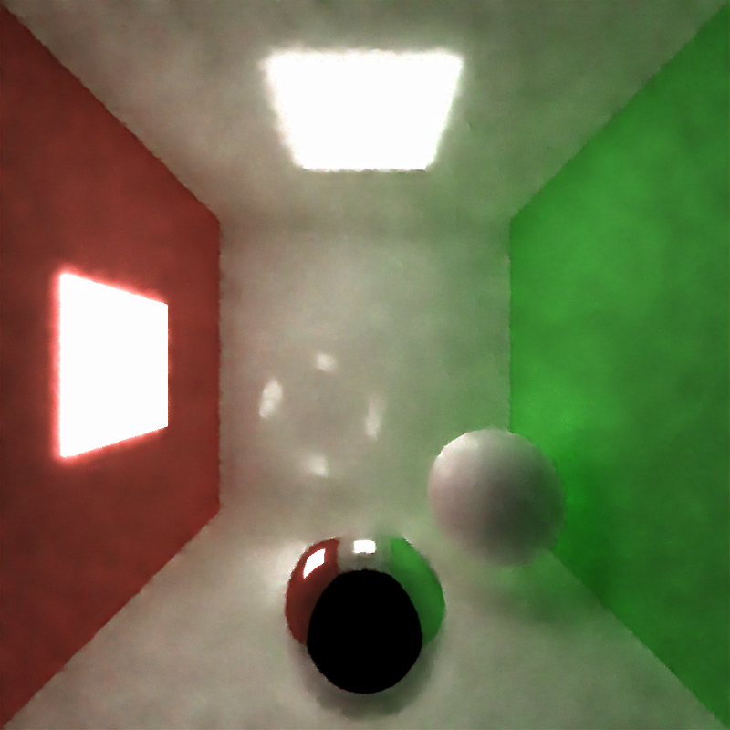
Progress
Completed data collection pipeline
Scene generation
Creates random scene files
Implemented bvh to speed up path tracer
Allows us to collect data with complex objects quickly
Collected/Collecting dataset for final demo/renders
Continued training the model with the collected data
Currently training a model with gbuffer data

Slide 4
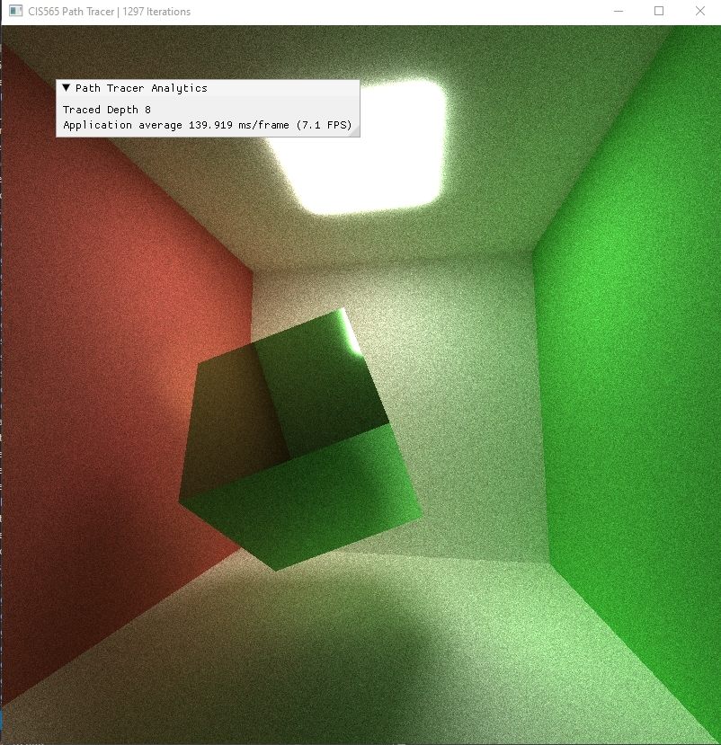
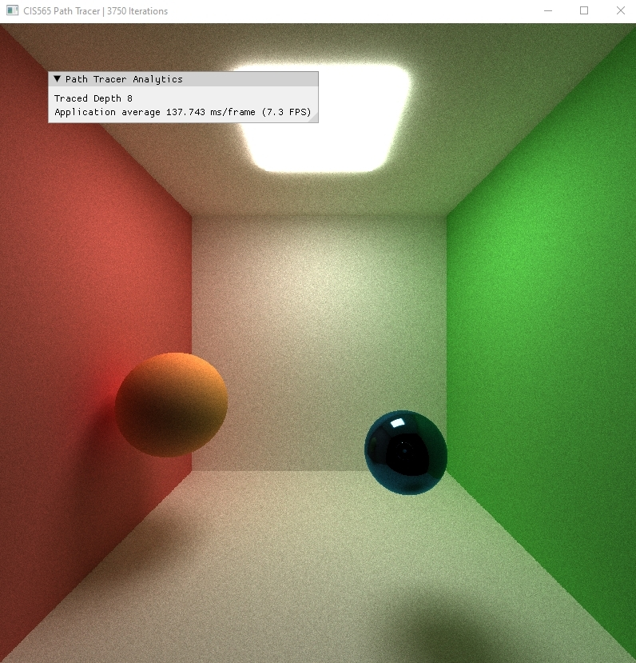
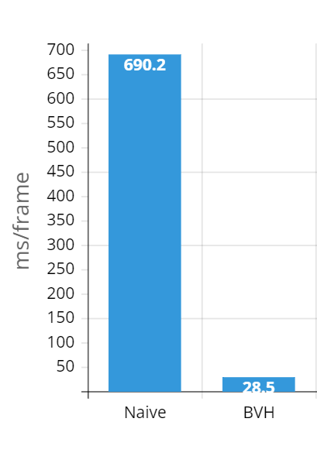
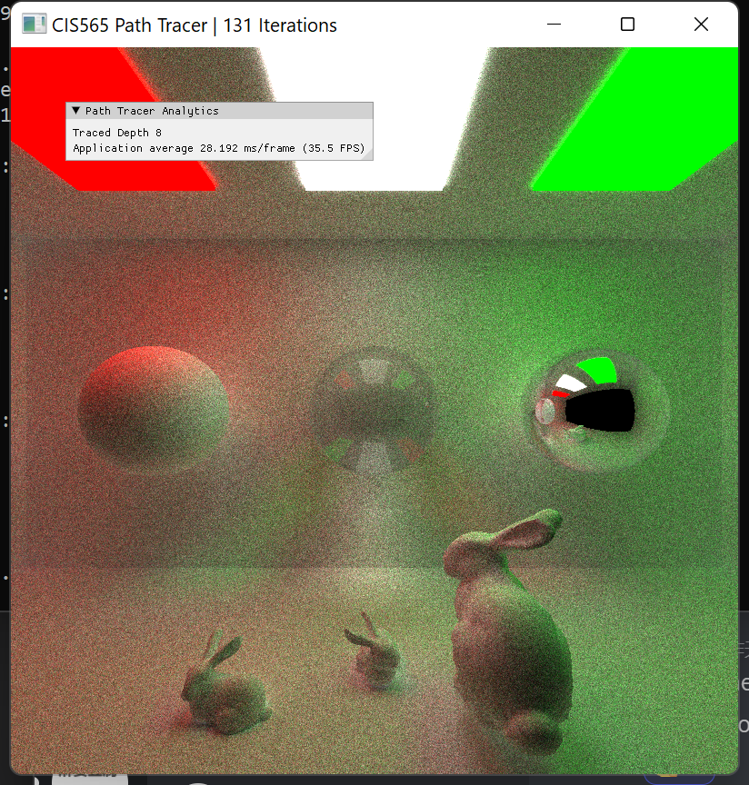

Slide 5
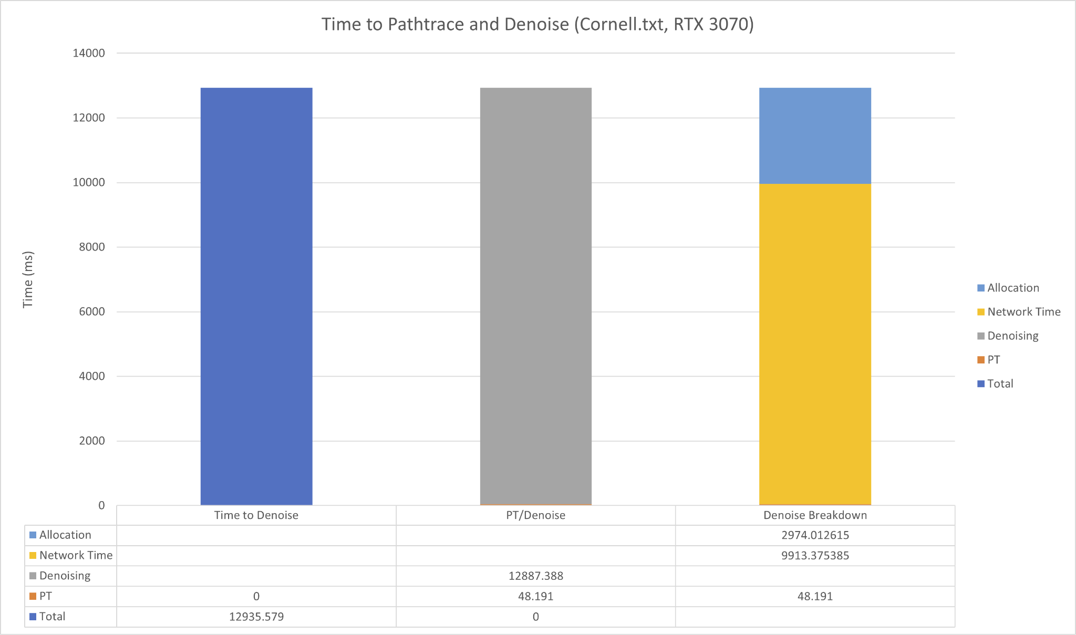
Performance

Slide 6
Progress
Completed cuDNN pipeline to run dnCNN model on path traced image
Integrated cuDNN code into path tracer (live demo)
Initial performance analysis of runtime
Lots of memcpys / allocs that are slow
Currently in the process of implementing VDSR (super resolution) in cuDNN

Slide 7
Live Demo

Slide 8
Next Steps
Optimize cuDNN code to get better performance
Finish implementing VDSR model in cuDNN
Continue data gathering / model training
Render final scenes / demos
More performance analysis
Polish code / README / repo

